Slide 1

Software engineer
Project - PicU
11610511 Shiyi Li
11610615 Mengwei Guo
11611827 Zhijian Wang
11610220 Hao Tan
11610402 Kai Wang

Slide 2
Division of Labor
Shiyi Li - Developer & Tester
Mengwei Guo - Designer & Developer
Zhijian Wang - Developer & Tester
Hao Tan - Developer & Tester
Kai Wang - Documentation & Tester

Slide 3

What’s the PicU?
4
“Picture of yourself”
Basic photo editing
Take photos / stylize it!
Save and share
2
1
3

Slide 4
Main Screen
Photo albums (edit)
Camera (take photo)
Image stitching
Drawer layout (settings)
4
2
1
3

Slide 5
Time Line
Week | Feature1 | Feature2
8 | Basic UI | Dark Mode
9 | Image embellishment manually | Take photo / Select photo from album
10 | Picture auto embellishment | Share to everywhere
11 | Default style transfer | Fix OOM
12 | Movable chartlet | Basic filters
13 | Login | Image stitching(1)
14 | Image stitching(2) | User setting

Slide 6
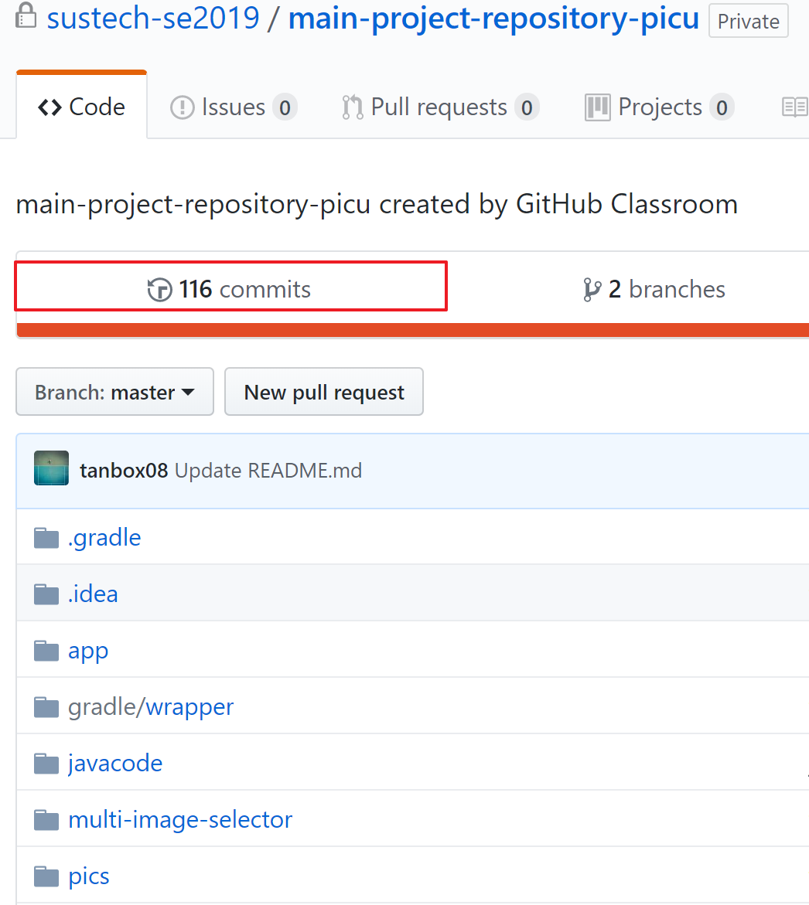
Time Line
110+ commits
Week commits
No lazy guys

Slide 7
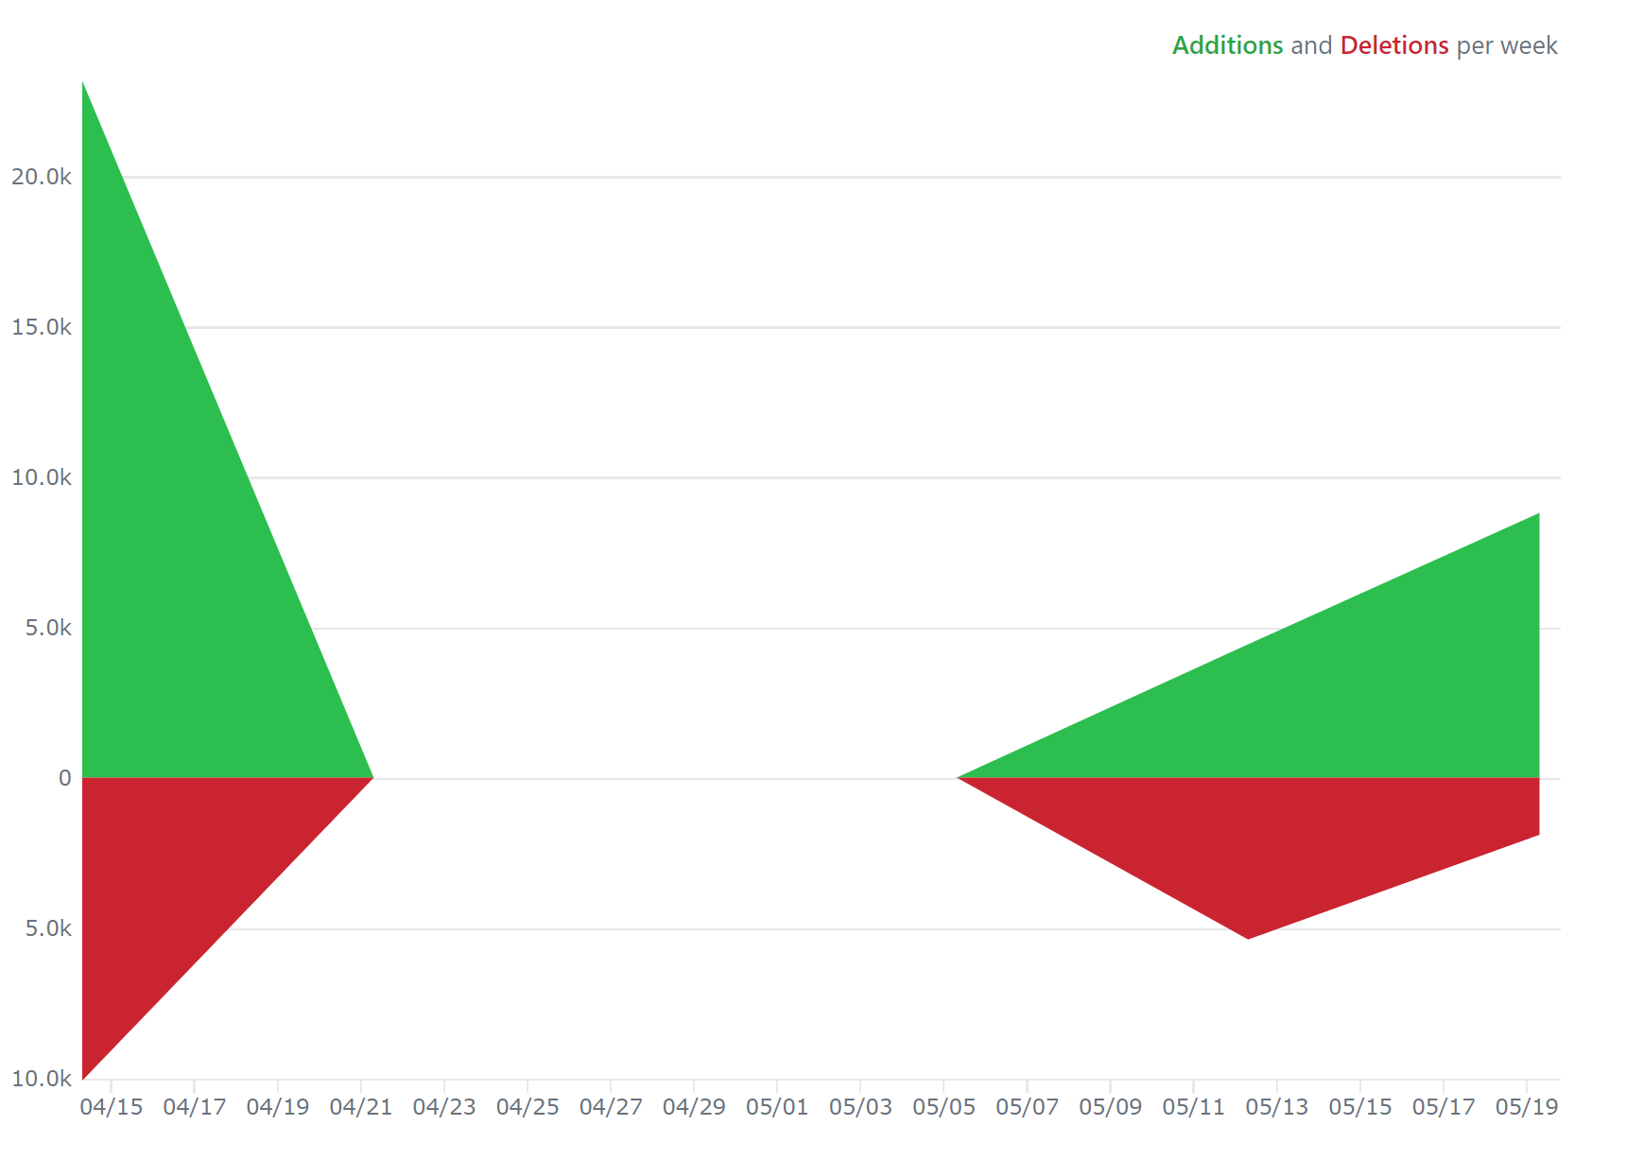
Time Line
110+ commits
Week commits
No lazy guys

Slide 8
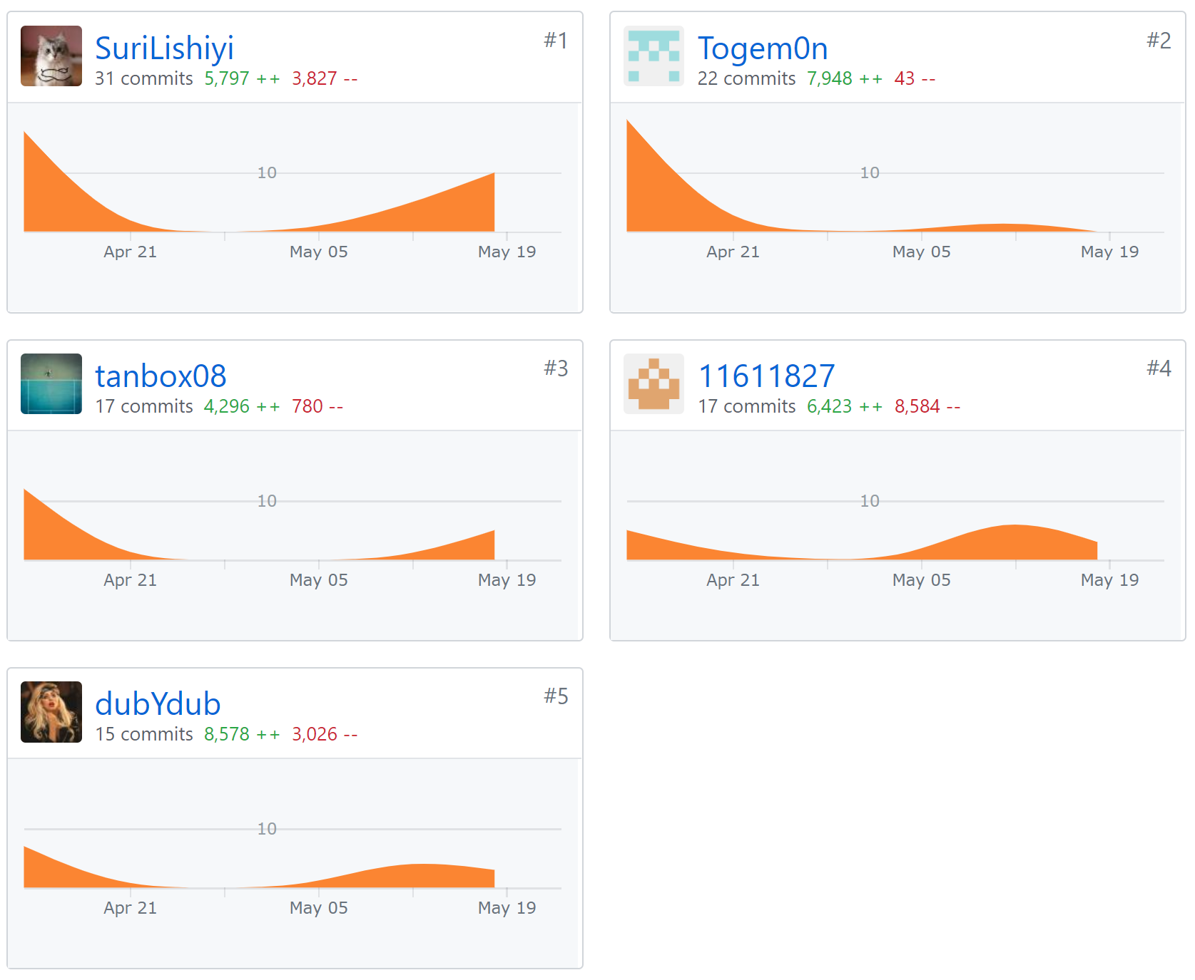
Time Line
110+ commits
Week commits
No lazy guys

Slide 9
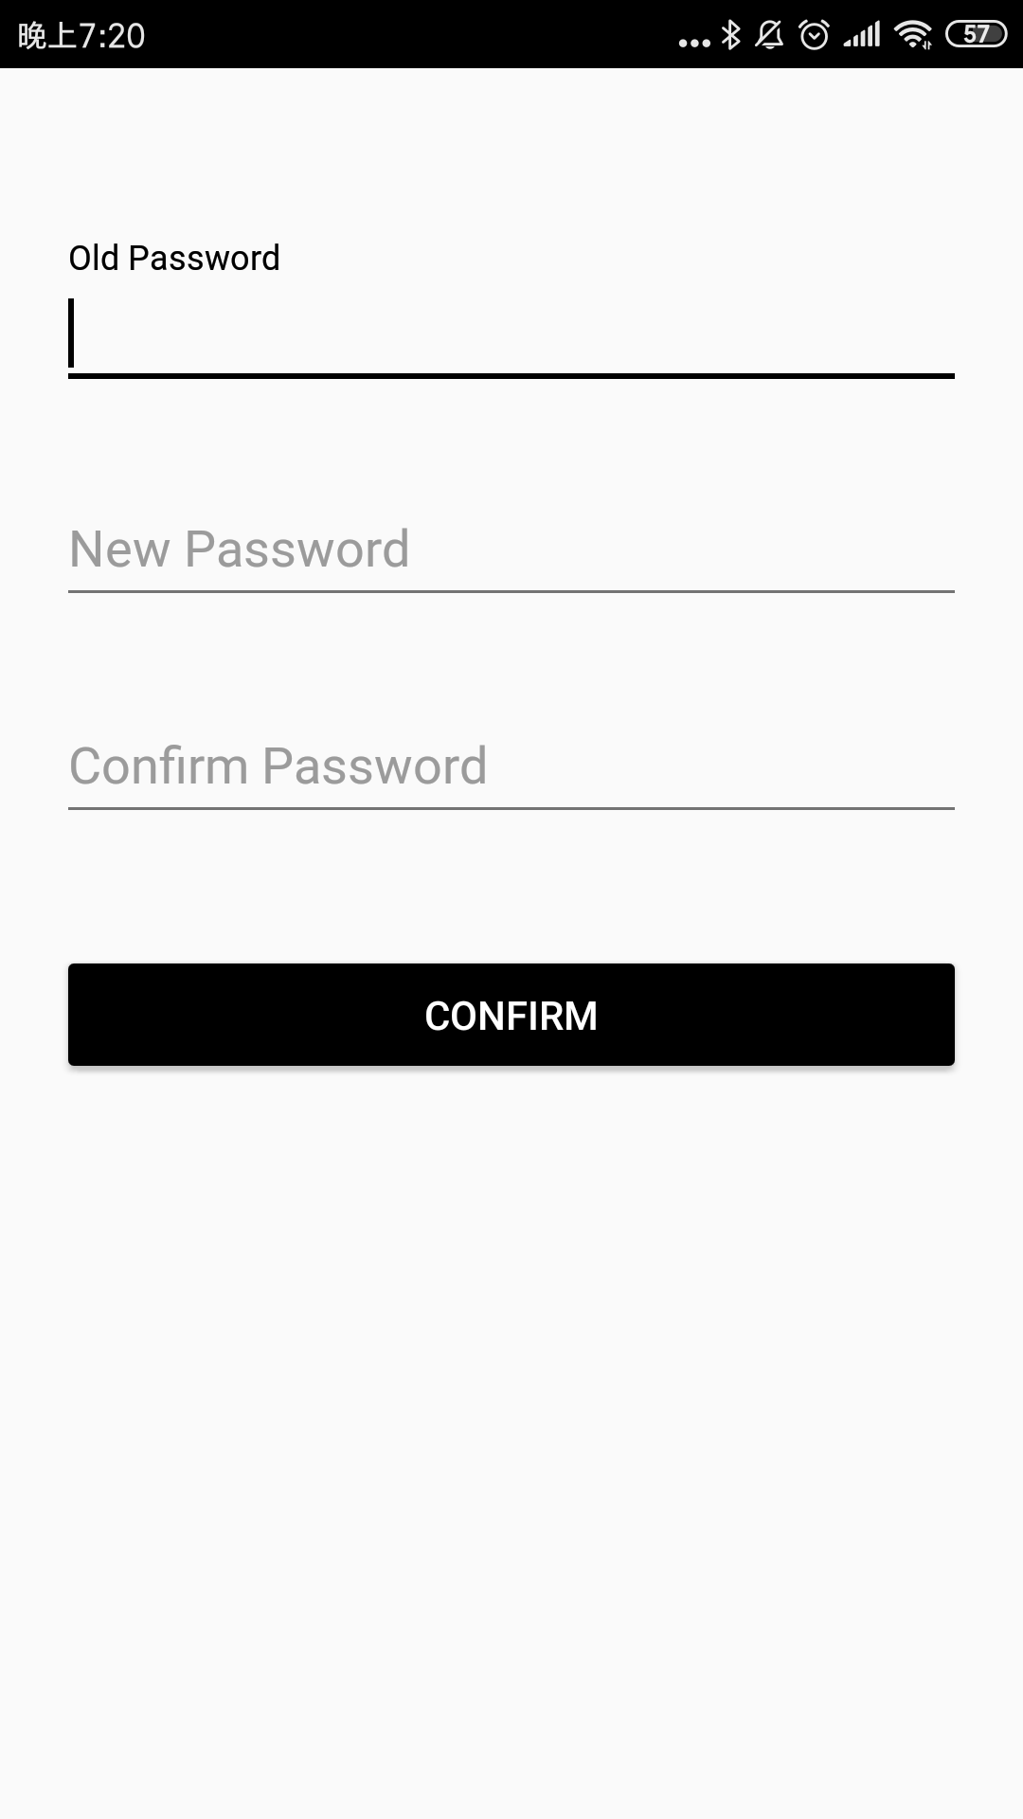
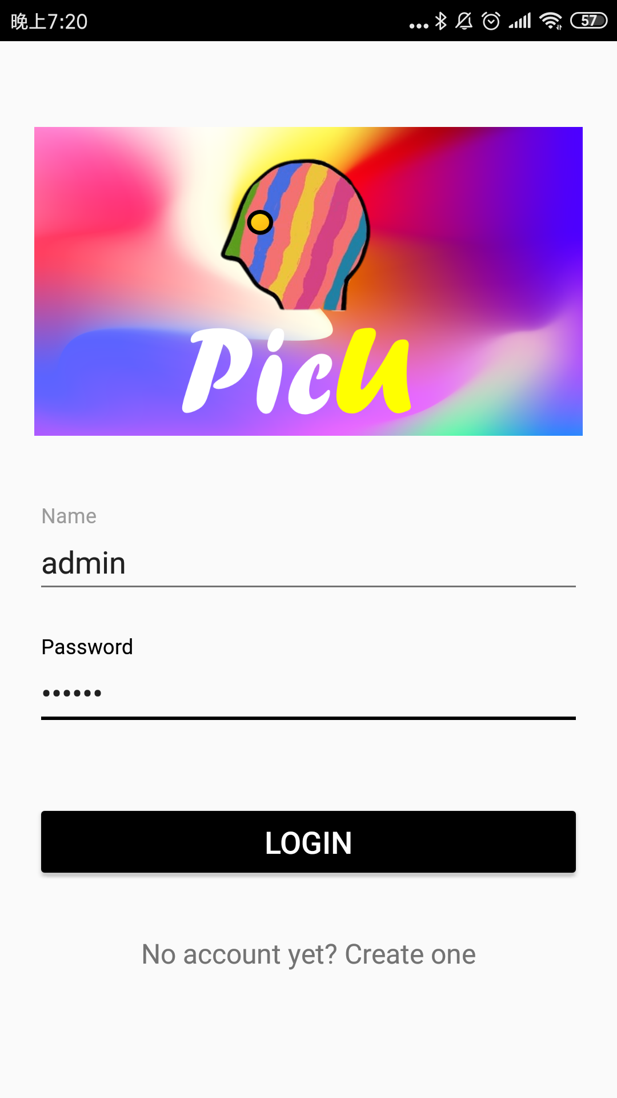
Features
Login
Password fix

Slide 10
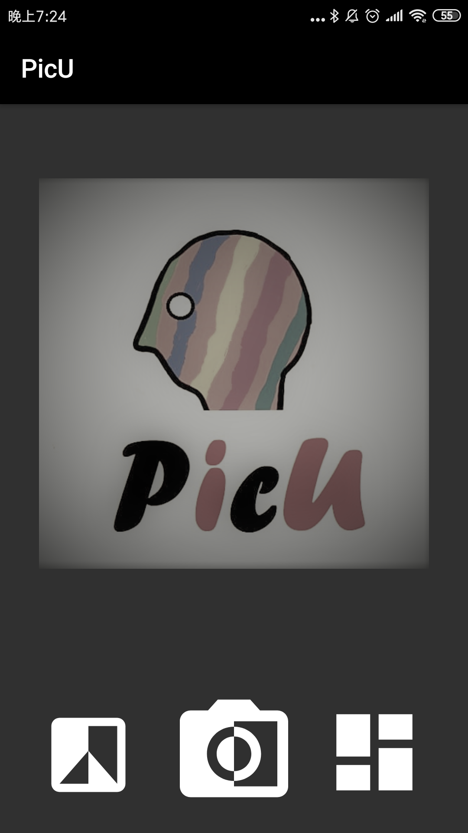
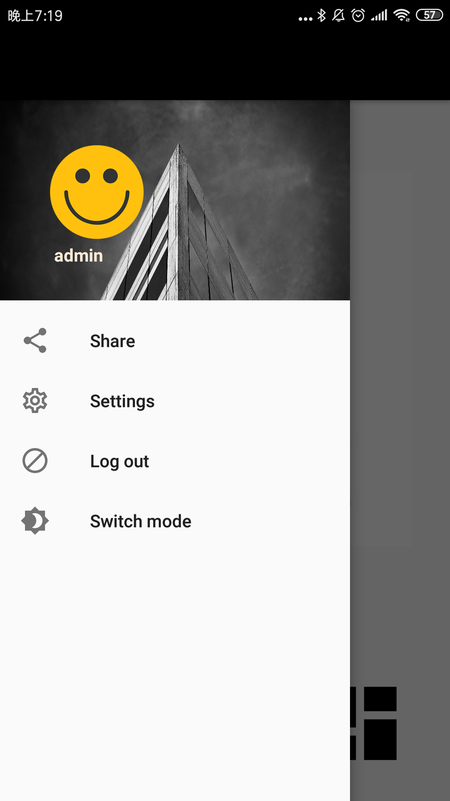
Features
Dark Mode

Slide 11
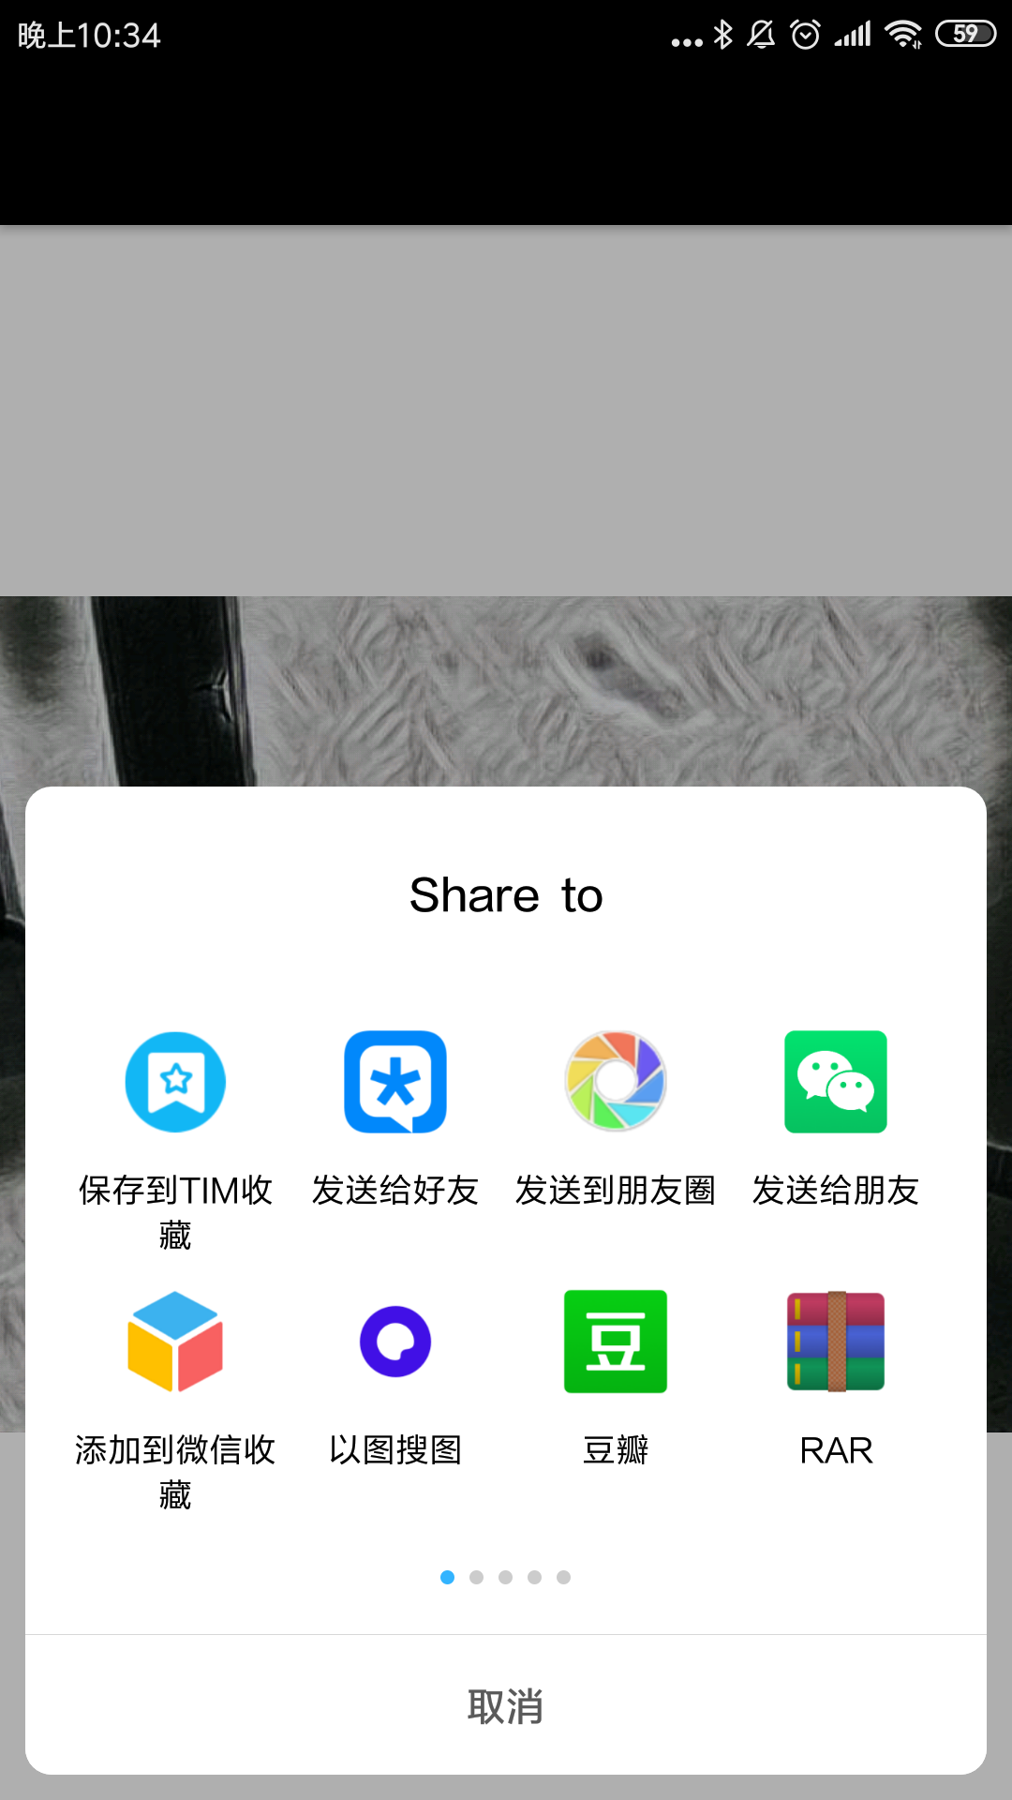
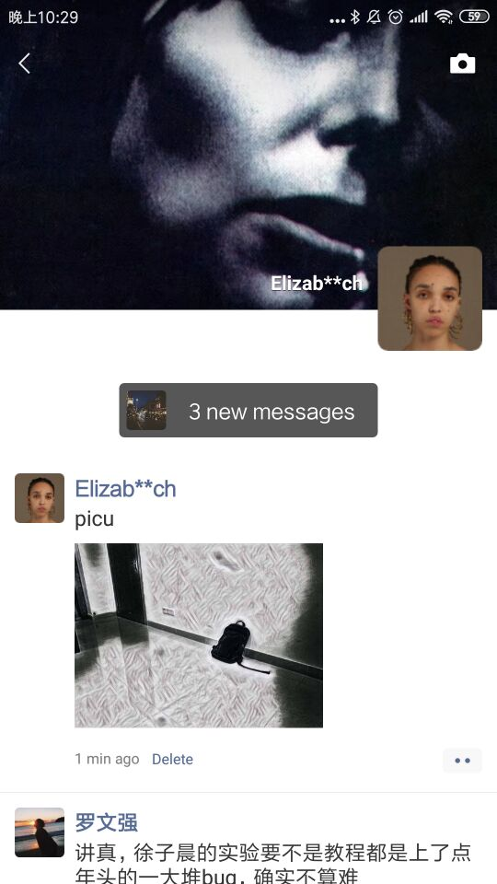
Features
Share
QQ
WeChat
Moments
E-mail
………

Slide 12
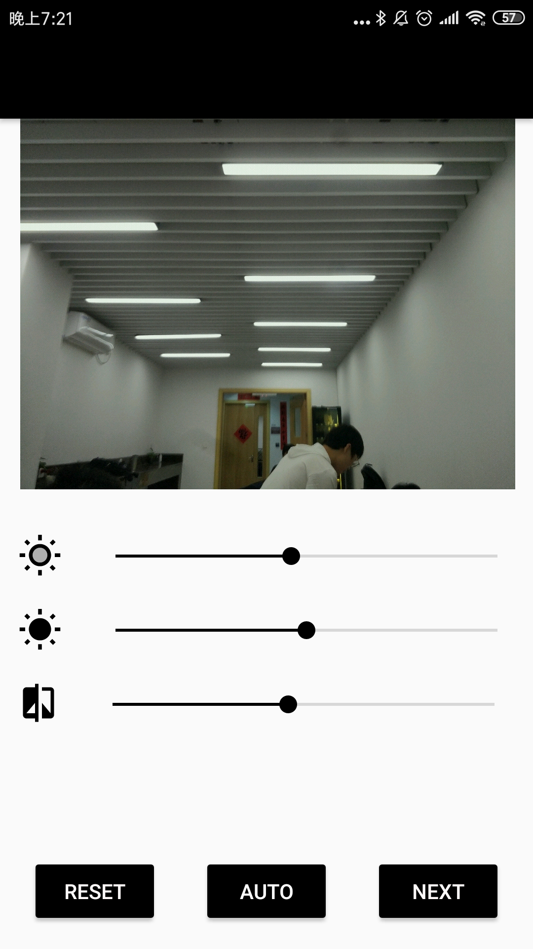
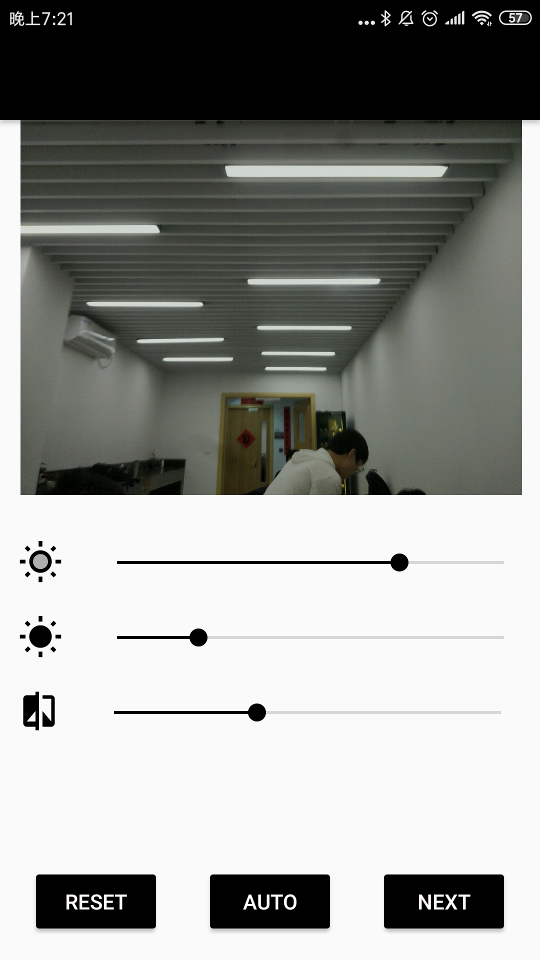
Features
Photo Attribute
Lightness
Contrast ratio
Saturation
Auto photo fix

Slide 13
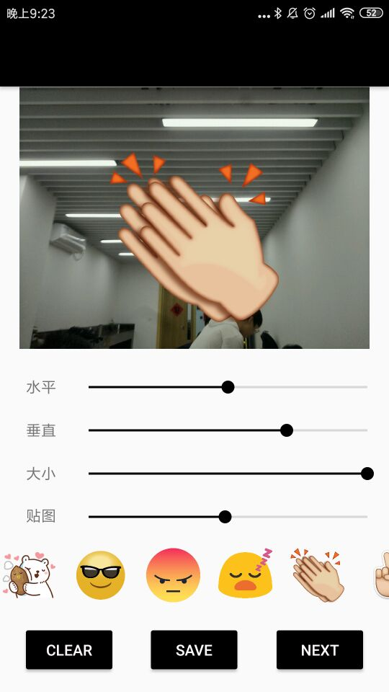
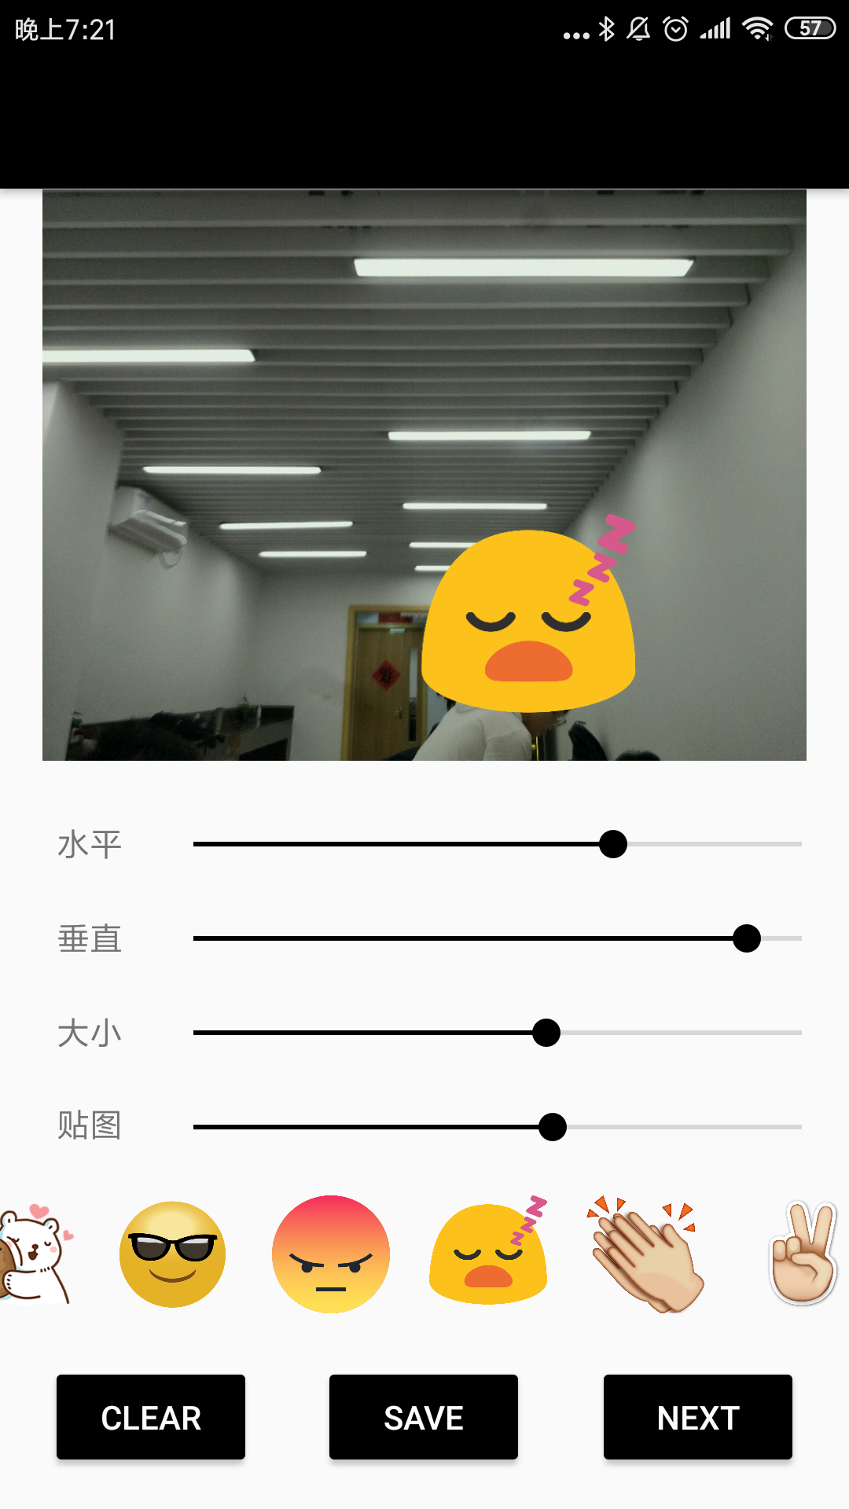
Features
Chartlets
Size
Position
Types
Save photo here

Slide 14
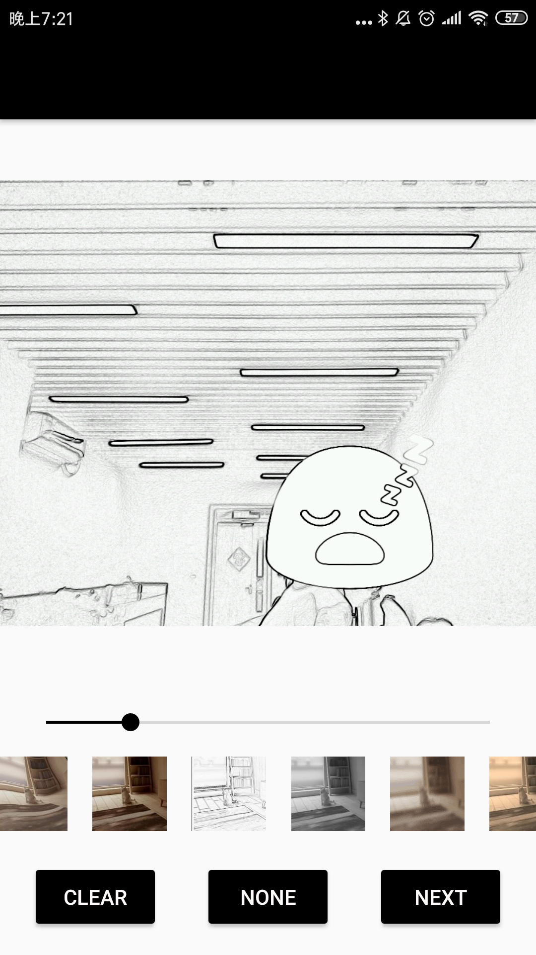
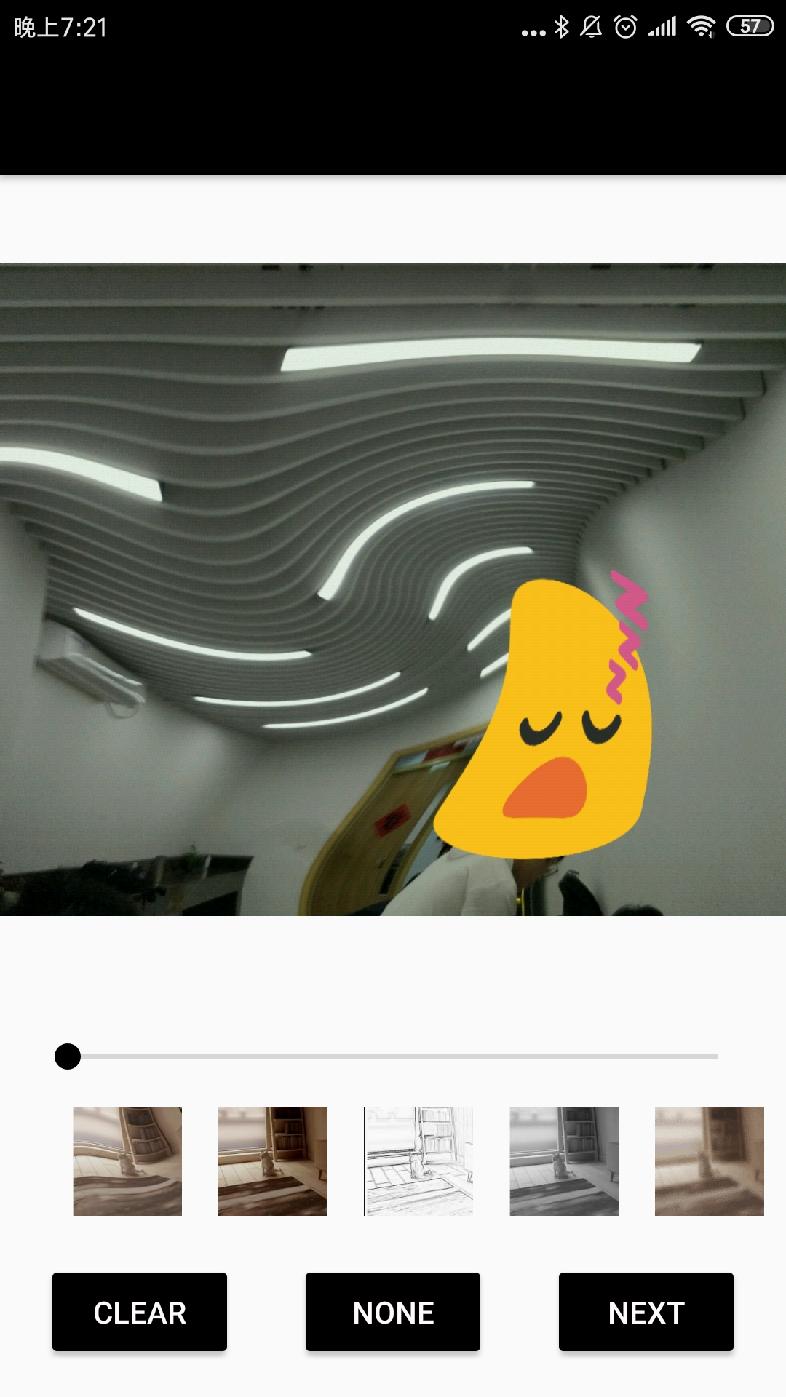
Features
Filters
Color
Shape
Texture
Save photo

Slide 15
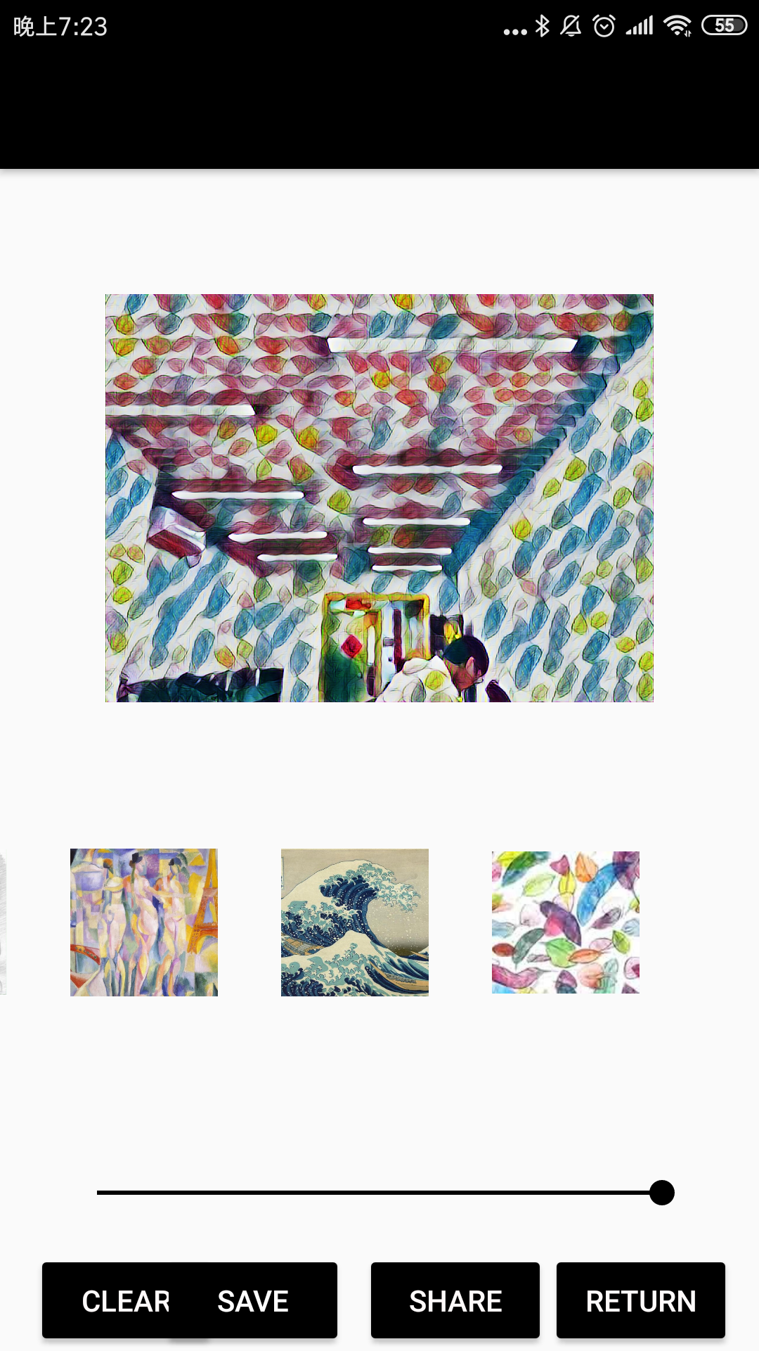
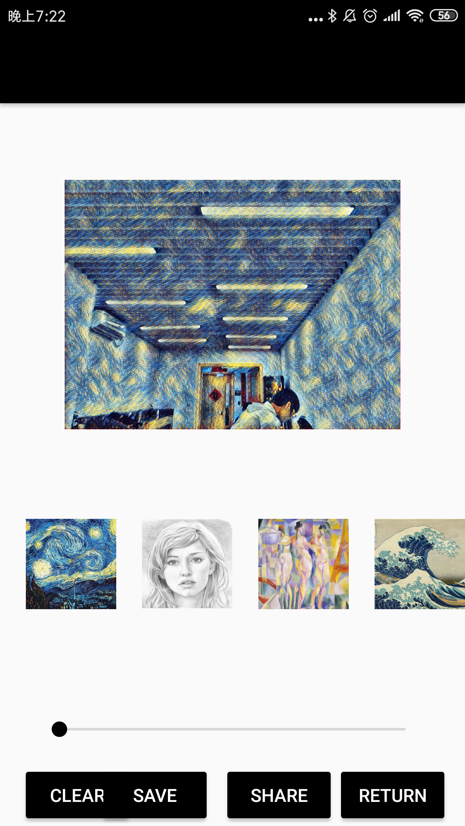
Features
Neural style
5 styles
Tensorflow
Crash
(sometimes)
Save photo

Slide 16
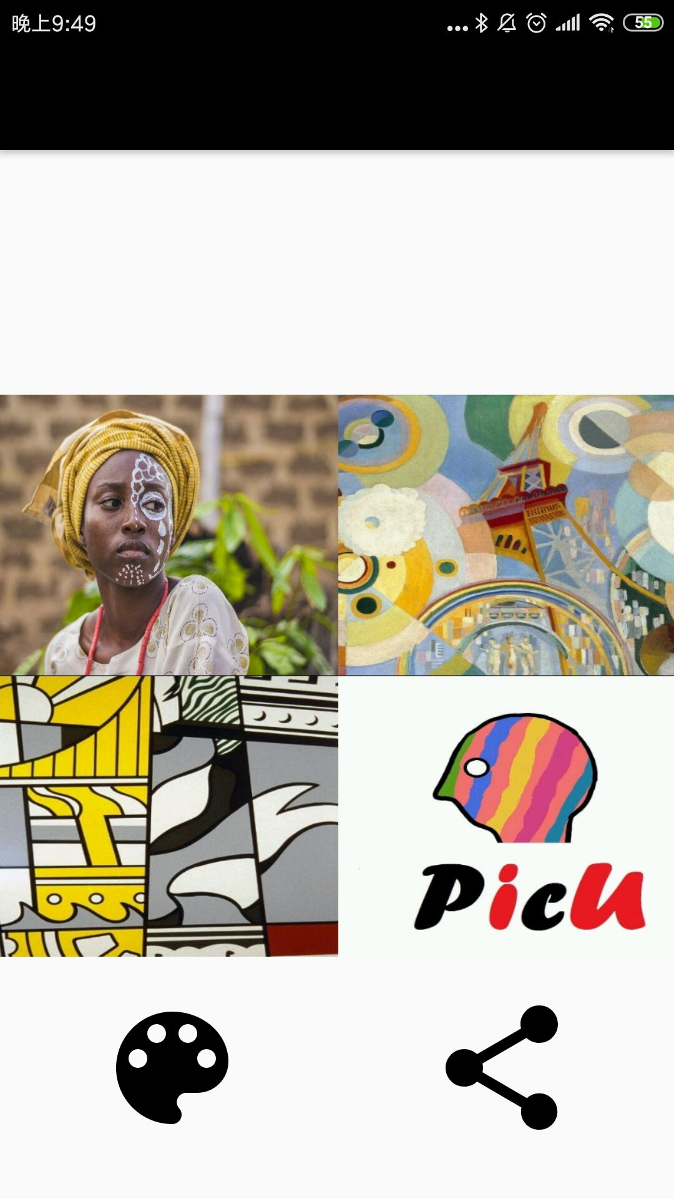
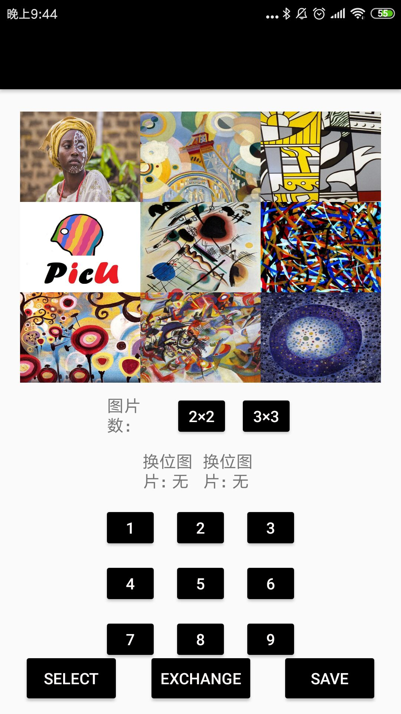
Features
Photo puzzle
2x2, 3x3
Multiple selection
Position Change
Save photo

Slide 17
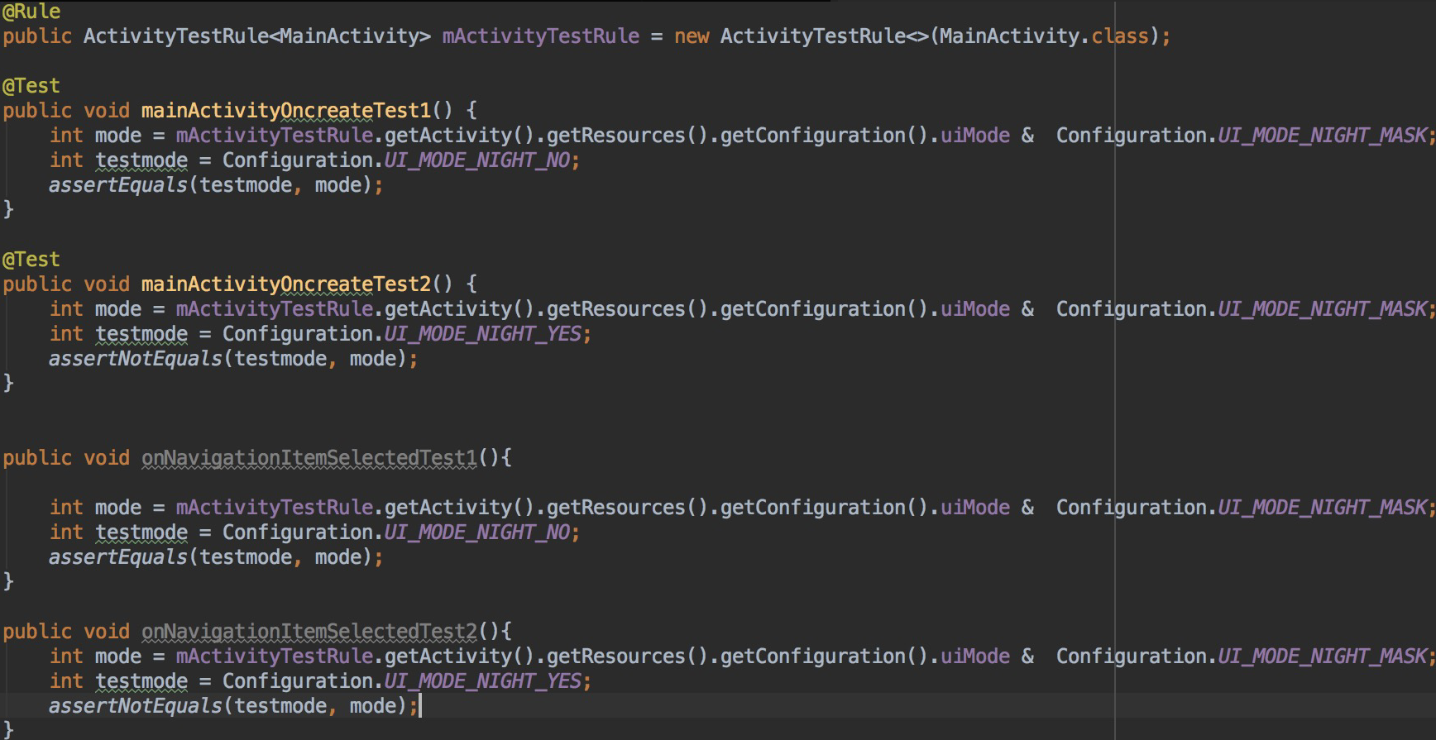
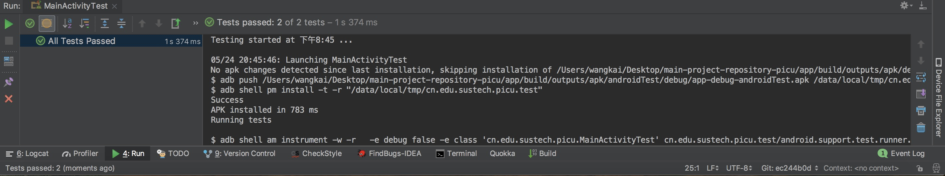
Testing techniques
Junit test 1

Slide 18
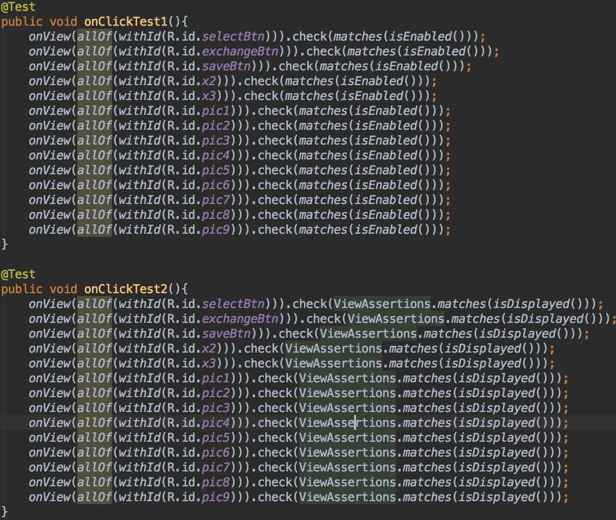
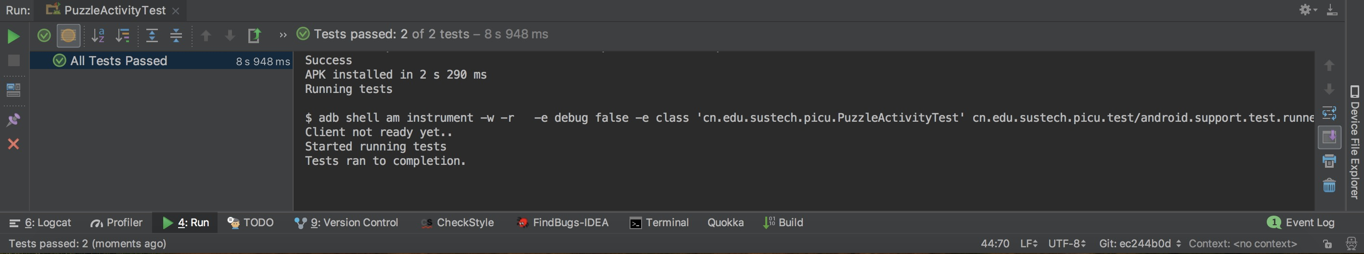
Testing techniques
Junit test 2

Slide 19
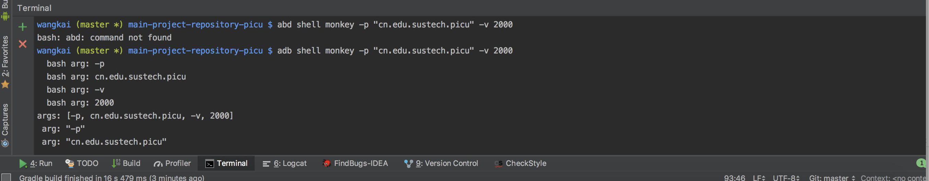
Testing techniques: MonkeyTest
Command

Slide 20
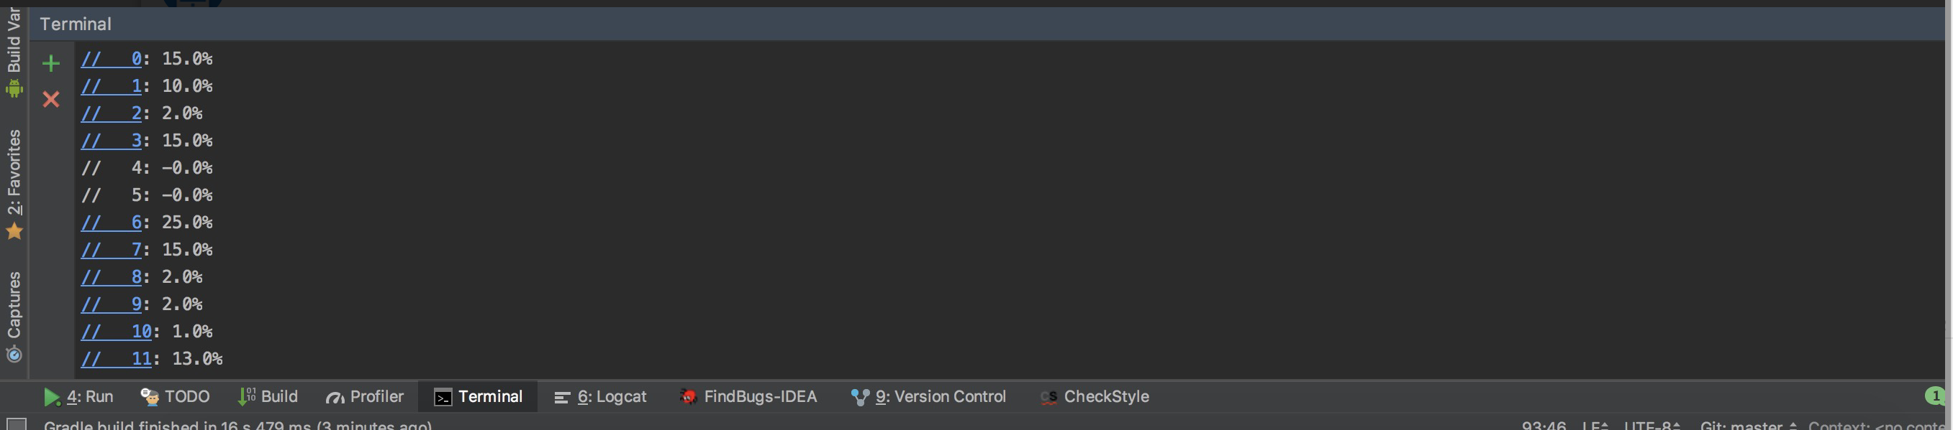
Testing techniques: MonkeyTest
Proportion

Slide 21
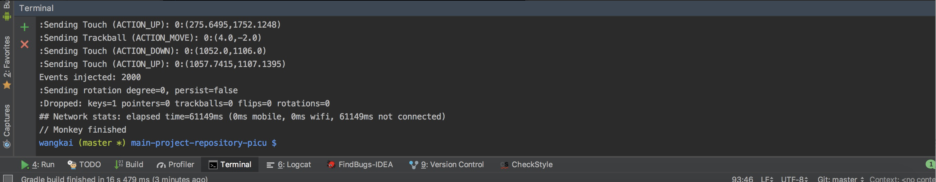
Testing techniques: MonkeyTest
Test Result

Slide 22
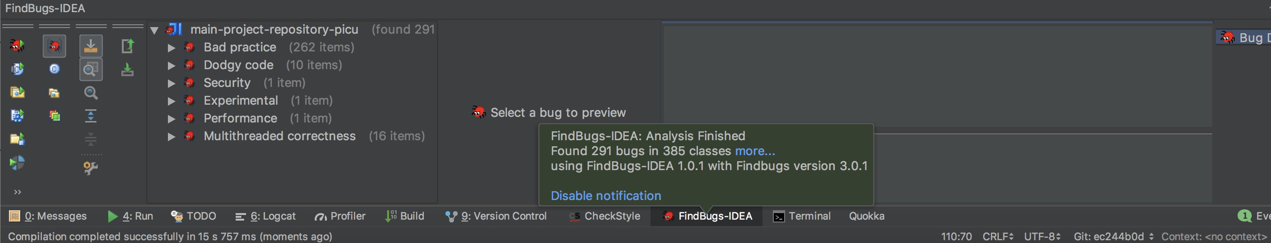
Analysis tool: FindBugs

Slide 23
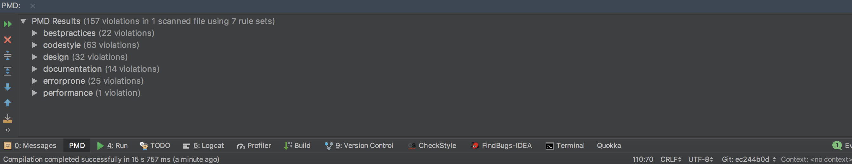
Testing techniques: PMD

Slide 24
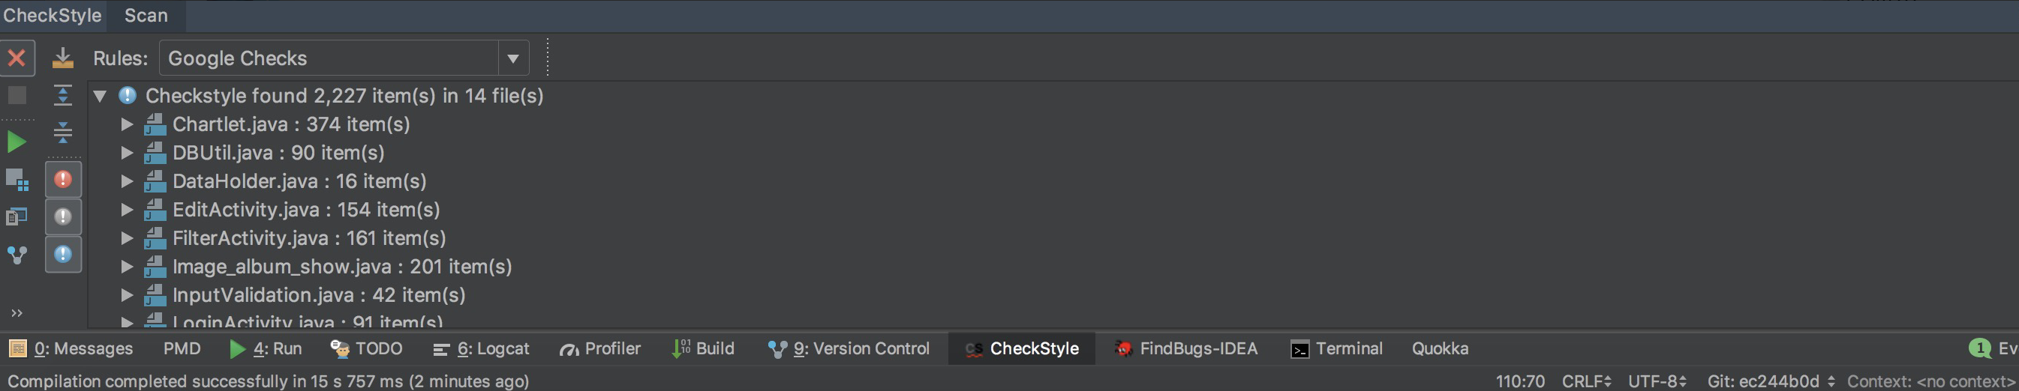
Testing techniques: CheckStyle

Slide 25
Scenario
Want a more artistic photo shot by yourself ?
Want to add some chartlets to image to show your mood?
Want to combine your favorite photos together?
Want to share your photos to your friends?

Slide 26
Conclusion
We want to let user can edit the picture and make it become an artware.
The main function all are finish, although the UI and others are not good enough for user’s experience.
We have learnt lots of thing, broke through the difficulties and
achieved our goal.

Slide 27
Future Work: What we find?
Develop a system is not only about develop, test is also an important part
Enable our app to adapt all android devices is not an easy work
Be careful, careful, careful about our code
Use version control tools to track out work

Slide 28
Future Work: What was difficult?
Picture editing is so dangerous, we met OOM million times.
It’s hard to keeping up with the steps of other team members. Communication is everything.
Keeping confident is hard when you failed so many times

Slide 29
Future Work: What do you wish you could have done?
A more user-friendly UI
More fluently style transfer function
Slide menu by finger, not by seekbar

Slide 30
Future Work: What’s next?
Enable more kinds of functions
mosaic
add words
more filters
more layouts in image stitching

Slide 31
